Slide 1

Unit 3:- HYBRID AND ELECTRIC DRIVETRAINS

Slide 2
Syllabus…Unit 3 Focus On….
Lecture | Topics to be covered
L1 | Basics about battery, Energy source used for EV’s & HEV’s, Ragone Plot,
L2 | Battery Performance Characteristics- Battery Capacity, Open circuit terminal voltages, Charage and Discharge rates, SOC, SOD, DOD, Battery Energy Density, power density, Specific energy and Specific Power.
L3 | Types of batteries. Comparison of batteries, Ultra capacitors and Ultra flywheels, fuel cells. On board energy sources.
L4 | Charging schemes for EV’s, charging characteristics, different types of charging, CC, CV, CCCV, MSC, Pulse charging & Trickle charging.
L5 | Conductive and wireless power transfer, Inductive Power Transfer, Battery Management system (BMS) for EV and HEV,
L6 | Vehicle to grid configuration, EV energy systems and configuration
L7 | HEV modes of operations starting the system, acceleration and deceleration of the system, normal driving, regenerative braking, the charging of the battery when the vehicle is in motion or when the vehicle is at rest.

Slide 3
Vehicle to grid technologies
Comprises of:
Grid-able Evs: EVs which can be connected to grid
Utility or power system
Information technology
Electric vehicles use batteries for energy storage systems, therefore because of the availability of batteries and if that EV is capable of connecting to grid, it is possible to use those batteries as power generators and it is possible to interchange energy between the battery and the grid or grid to the battery while charging. Therefore, this technology enables integration of energy flow and the information flow such that both the EV owners and the power grid or the power system gets benefited

Slide 4
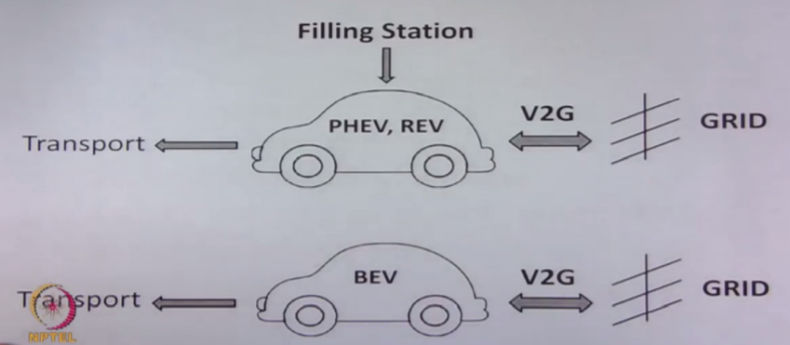

Slide 5
grid-able EVs
EVs which can be connected to grid are known as grid-able EVs
Hybrid electric vehicle, PHEV and REV are grid-able, means they can be connected to grid for charging the battery
They can be also charged using petrol or diesel from a filling station.
BEV always charges the battery from grid, but it is also possible to connect these two systems such that they can enable the power flow from the vehicle to the grid. So this system requires the capability to transfer energy both from the grid to vehicle and from vehicle to grid.

Slide 6
V2G as a emerging new business model
It can communicate with the grid
--- can control the energy flow from the battery to the grid
---can also control the charging rate of the batteries
EV are unused for 95% of the Time
Each EV can typically store/generate between 4 kWhr to 80 kWhr
If EV in large scale then 20 to 40% penetration is there in the vehicle segment.
On mass scale It can create its own autonomous power storage.
May effect the power system dynamics and stability

Slide 7
Need of power aggregator: power aggregator has to take care of internal energy flow such that it minimizes the power demand and losses
Individual EVs V2G action is ineffective/insufficient
Create a pool of Evs and communicate to the grid
Performs energy arbitrage internally within the pool
--Enable V2V, V2B, V2H intragrid operators
--Minimizes power demand and losses
--Optimizes voltage deviations, Total Harmonic Distortion
--Estimate prices for maximum profit

Slide 8
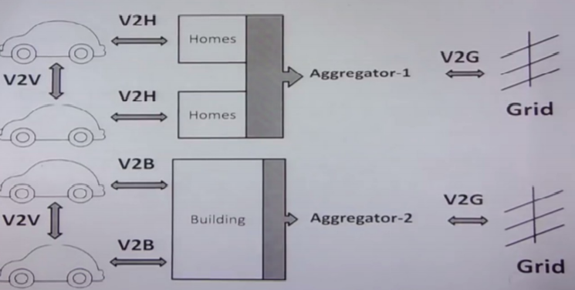

Slide 9
V2G applications in Power systems
Co-ordinated charging and peak shaving
Active regulation
Spinning reserve
Motor starting
Reactive Regulation
Renewable transients etc

Slide 10
Power convertor for V2G operation
battery bank and 2 power converter
source of energy 3-ph(connect a diode rectifier) for charging capability
use of bidirectional power converter which can support the energy flow from battery to the grid
DC link as electrolytic capacitors, so this can be used to support, reactive power support to the grid
act as a shunt to the grid and it can enable in maintaining the THD of the grid and also support reactive power compensation required during voltage regulation and motor starting
called basically grid side converter

Slide 11
EV energy systems and configuration
EV requires multidisciplinary technologies:
Electrical engineering: Electrical machines, power electronics, control systems, energy and battery management systems and charging
Mechanical and automobile engineering:
Gearing, differential, chassis, suspension, braking, steering etc
The knowledge of IC engine is required in a HEV or hybrid electric vehicle.
Chemical engineering :
knowledge of battery, fuel cell, liquid and gaseous fuels and its different kind of chemical features are required to be known

Slide 12
EV configuration
Converted EV
Heavy wt, loss of flexibility
Purpose Built
Energy flow via flexible wiring
Propulsion ( single/multiple motor)
Energy sources( hybrid, charging systems)

Slide 13
Components of a typical EV system
Electrical propulsion system:controller, power converter or power electronics, motor, transmission gears, differential, wheels etc
Energy source subsystem:Energy source, selection of energy source, design of chargers or the refilling systems, energy management system
Auxiliary subsystem: power steering, cooling arrangement, heating arrangement, infotainment etc

Slide 14
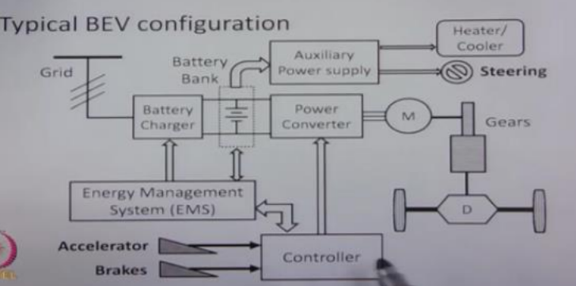

Slide 15
Converted EV’s-
Use the technology of IC engine
Longitudinal front engine, front wheel drives.
Replaces the IC engine with a similar rated motor, and the rest of the mechanical assembly is same like it has clutch, it has a gear box which is a variable gear system and a differential
Requirement of the motor is, it should work at full speed with capacity of delivering the full torque
Variable speed and variable torque operation is done by the variable gear systems by means of clutch system
Advantage:
SIMPLE, not need much expertise
Disadvantage:
Heavy wt, loss of flexibility
Applications
Three wheeler or a very smaller rated car with simple conventional motor.

Slide 16
VARIOUS CONFIGURATION OF EV
Longitudinal wheel drive (same mechanical assembly)
Longitudinal wheel drive( Fixed gear no clutch)
Transverse wheel drive
Transverse wheel drive ( Fixed gear no clutch)
Dual motor drive
In-wheel motor drive
Outer rotor motor drive

Slide 17
VARIOUS CONFIGURATION OF EV
WITH BATTERY ENERGY STORAGE
WITH HYBRID BATTERY
WITH FUEL CELL AS ENERGY STORAGE
WITH UC/FW AS ENERGY STORAGE
BEV configuration : system voltage

Slide 18
BEV configuration : system voltage
Motor Design is related to system voltage
High voltage motors
Reduces cost/size of power convertor
Need large no of batteries in series
Reduction of interior and luggage space
Weight/cost of vehicle will increase
Performance will degrade
System voltage is governed by battery weight
High power motors adopt high voltages

Slide 19
Differentiation between single/multiple motor configurations
 | Single motor | Multiple motor
Cost | LOW | HIGH
Size | LUMPED | DISTRIBUTED
Weight | LUMPED | DISTRIBUTED
Motor rating | HIGH | LOWER
Efficiency | LOWER | HIGH
Differential | MECHANICAL | ELECTRONIC
Controllability | LOW | HIGH
Reliability | HIGH | HIGH ONLY WITH FAULT TOLERANT CONTROL

Slide 20
Differentiation between Fixed/Variable Gear system
 | Fixed gearing | Variable gearing
Power convertor rating | Higher | Lower
Motor rating | Higher | Lower
Efficiency | Higher | Lower
Reliability | Higher | Lower
Motor design | Customised/complex | Conventional Motors
weight/size | Lower/smaller | Higher/larger
Cost | Lower | Higher
System operation | simple | Complex

Slide 21
Differentiation within wheel drives
Inner rotor type | Outer rotor type
High speed rotor | Low speed
Smaller size | bigger
Light weight | heavier
Lower cost | More costly
Speed reduction planetary gear-set is adopted | Gear-less
 | Simple

